Slide 1
Lecture 2 Pre-processing serological data
May 21, 2025
Seroanalytics Training Blantyre, Malawi

Slide 2
Lecture Outline:
What is pre-processing?
Why is pre-processing important?
When is pre-processing sufficient?
Pipeline for pre-processing data
Filter for quality (bead count)
Background correction
Transformation
Standardization
Normalization

Slide 3
What is preprocessing?
Pre-processing are steps you take to go from raw assay data to data that will be comparable across samples and plates in your study

Slide 4
Why is pre-processing important?
Pre-processing helps to adjust for sources of technical variation so that we can observe the true biological variation

Slide 5
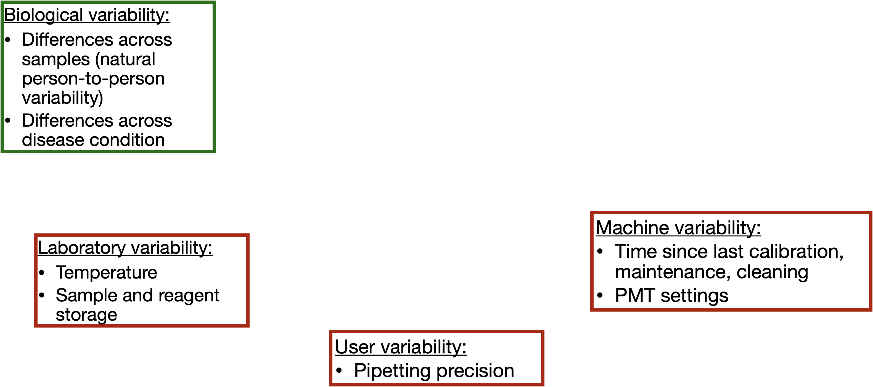
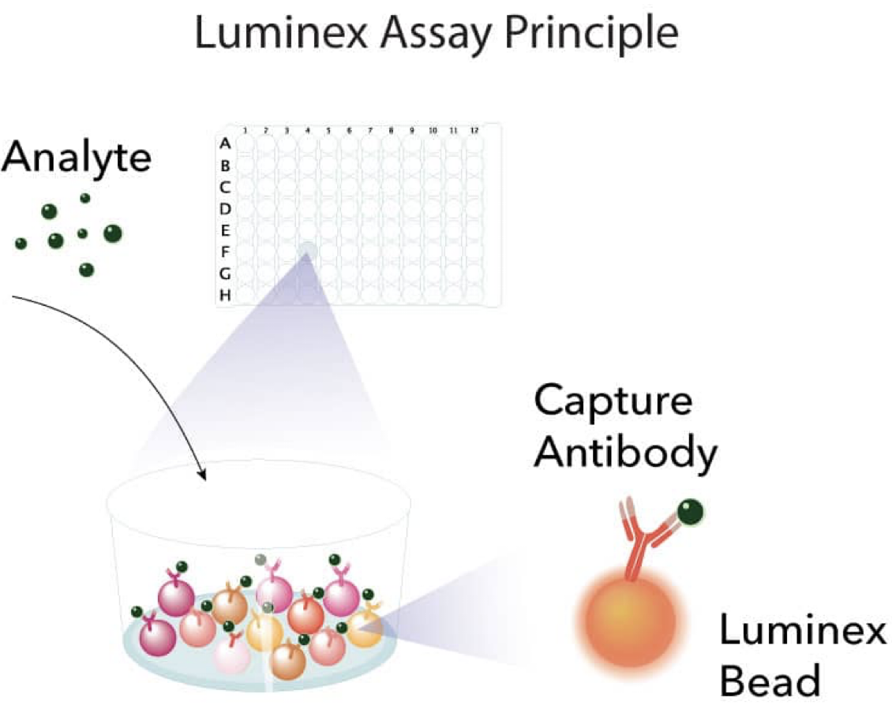

Raw MFIs contain biological and technical variation
Other differences are technical variation

Slide 6
Raw MFIs contain biological and technical variation
Other differences are technical variation

Slide 7
When is pre-processing sufficient?
Compare methods that result in high concordance between plates for the same samples
Ideally, you will have samples that are run on every plate (like standards or controls)
If samples are randomly split between plates, then distribution between plates should be similar

Slide 8
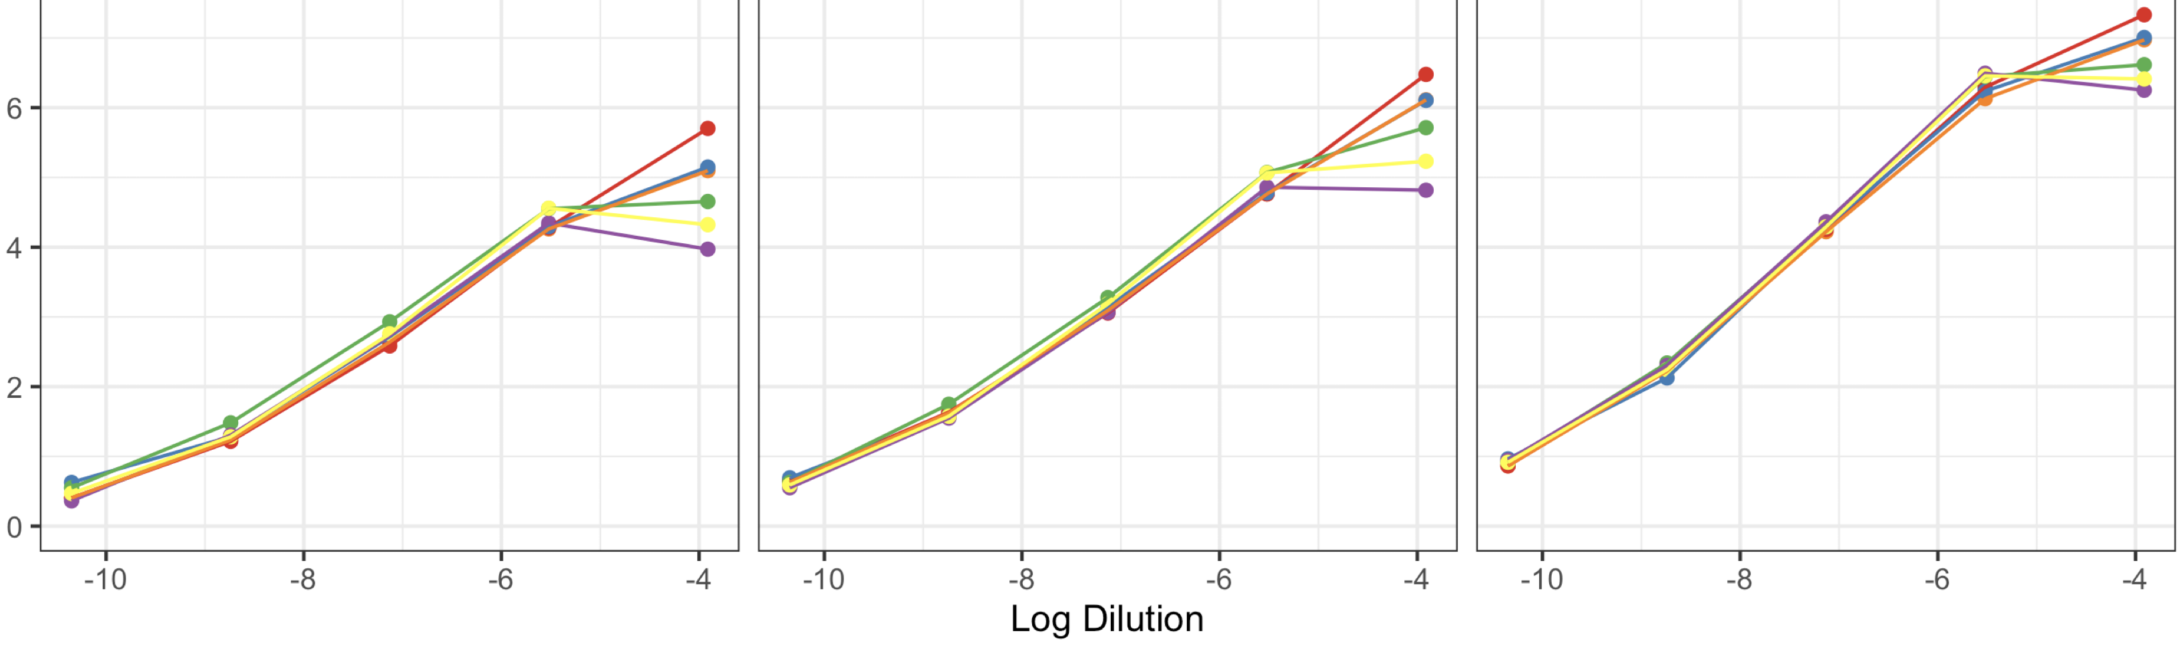
Raw MFIs contain biological and technical variation
Compare the same measurement (same sample, same antigen) across plates.

Slide 9



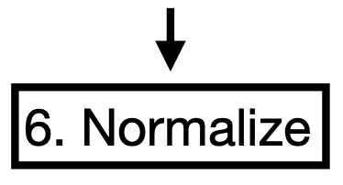
An example pipeline for pre-processing data
5. Fit standard curves and estimate log concentrations

Slide 10

An example pipeline for pre-processing data
We’ve already completed this step this morning

Slide 11
Reading in data
Show r code quickly reading in data (read.csv and head(dat)

Slide 12
An example pipeline for pre-processing data

Slide 13
Remove low bead counts
It is important to have raw data that includes bead count, since low bead count indicates low quality data
Filter out samples that have a low bead count (low quality data)
Set a threshold for minimum bead count (eg 30 or 50 beads / antigen/ well)

Slide 14
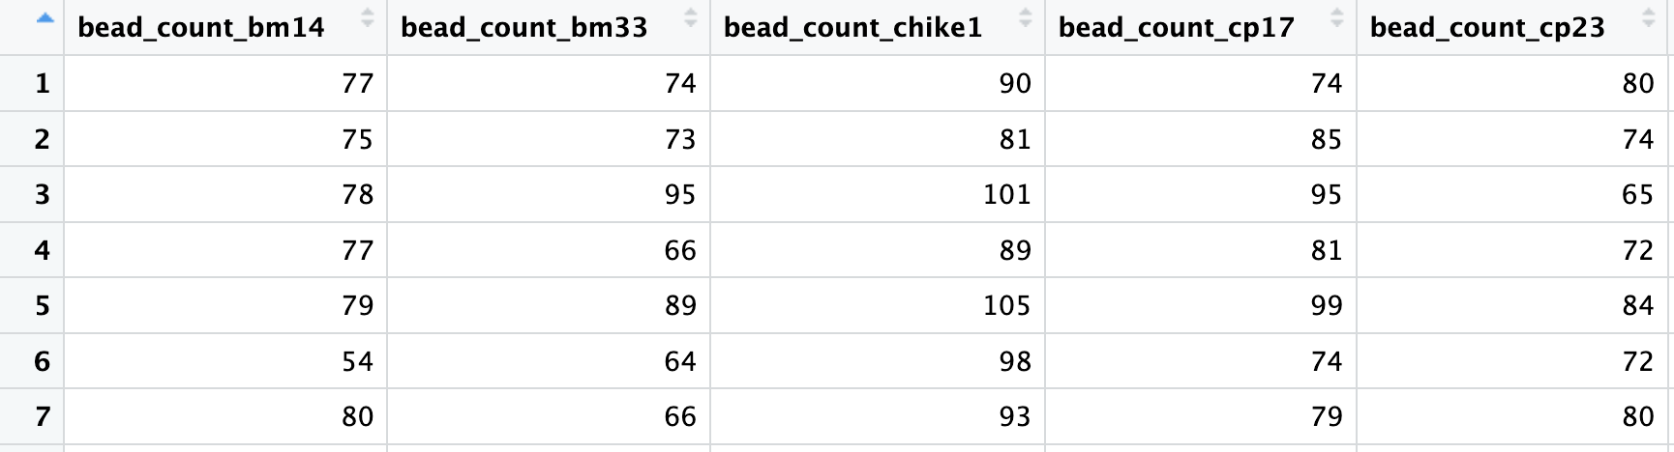
Your data should have bead counts specific to each antigen

Slide 15
Remove low bead counts
Filter out samples that have a low bead count (low quality data)
Show R code to filter (bread bead count function)

Slide 16
An example pipeline for pre-processing data

Slide 17
What is background correction?
Background is the non-specific signal that present in all wells.
Background correction removes this signal so that measurements reflect true antibody–antigen binding
Potential sources of background could be: plate effects, nonspecific binding, bead autofluorescence

Slide 18
Background correction
Techniques to correct for background signals:
• Blank subtraction: MFI_sample - MFI_blank
• Background division: MFI_sample / MFI_blank

Slide 19
Background correction
Example in R, walk through code showing adjusting for background with subtraction or division, and show comparison of results

Slide 20
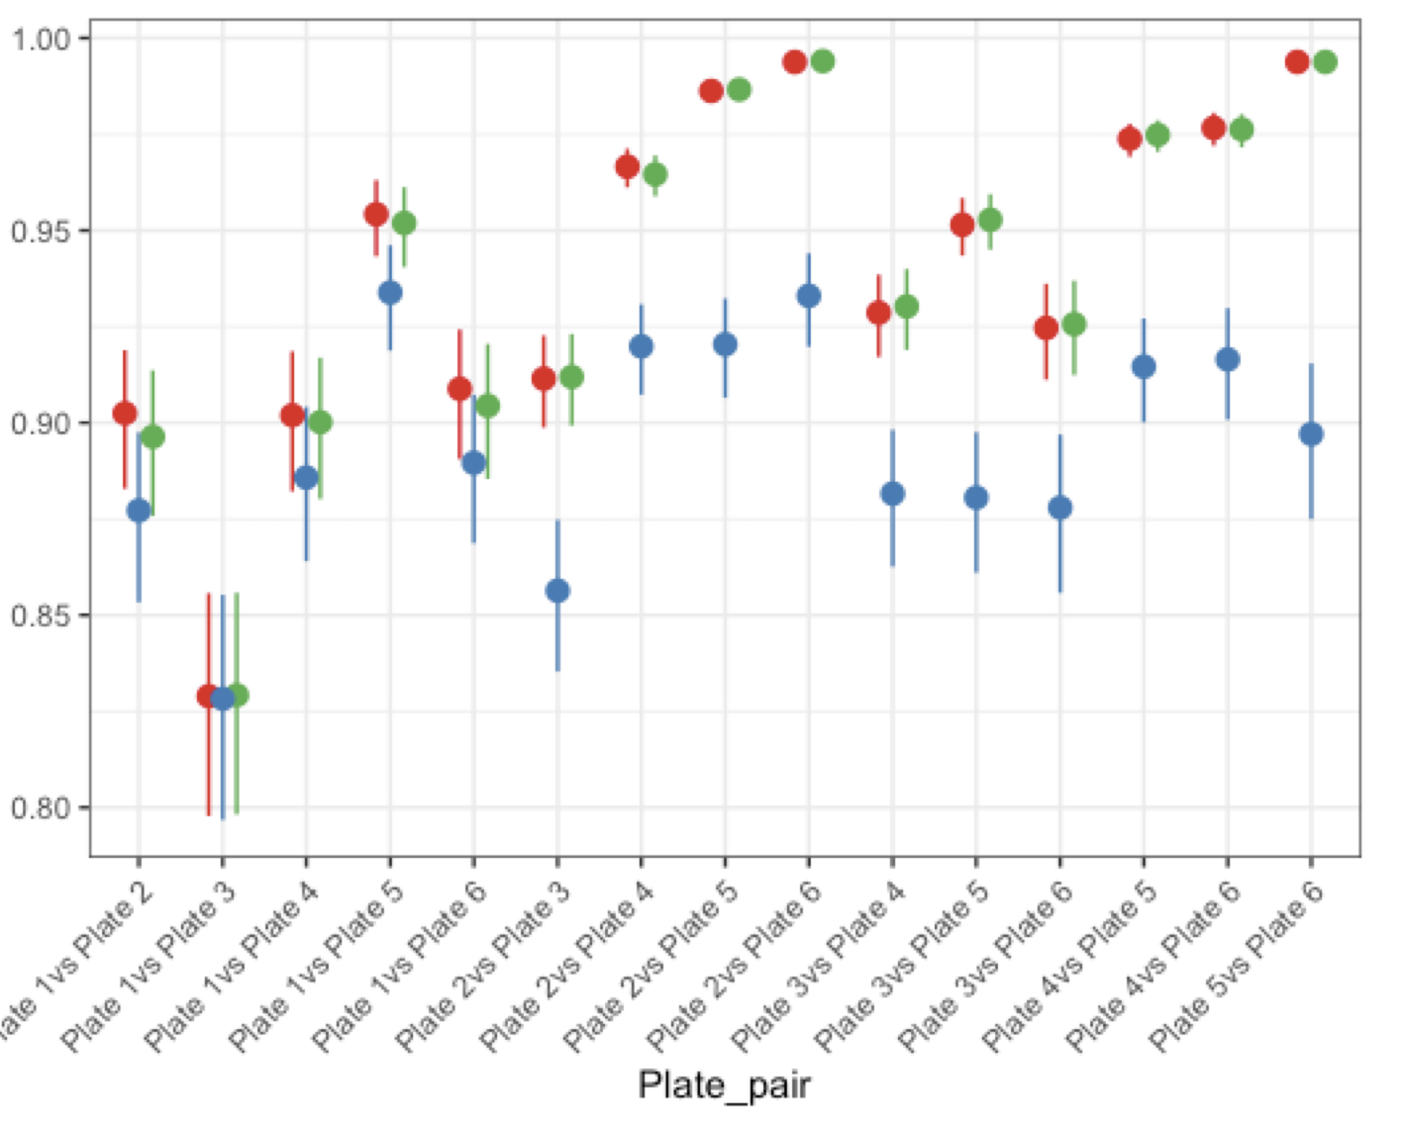
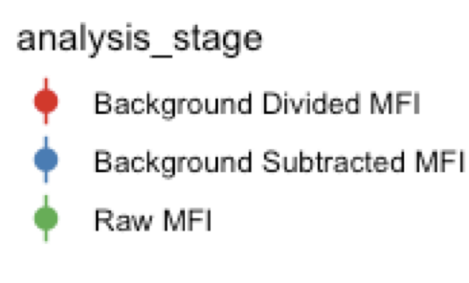
Example results of background correction
MBA for malaria study (6 x 384 well plates, 19 P. falciparum antigens)

Slide 21
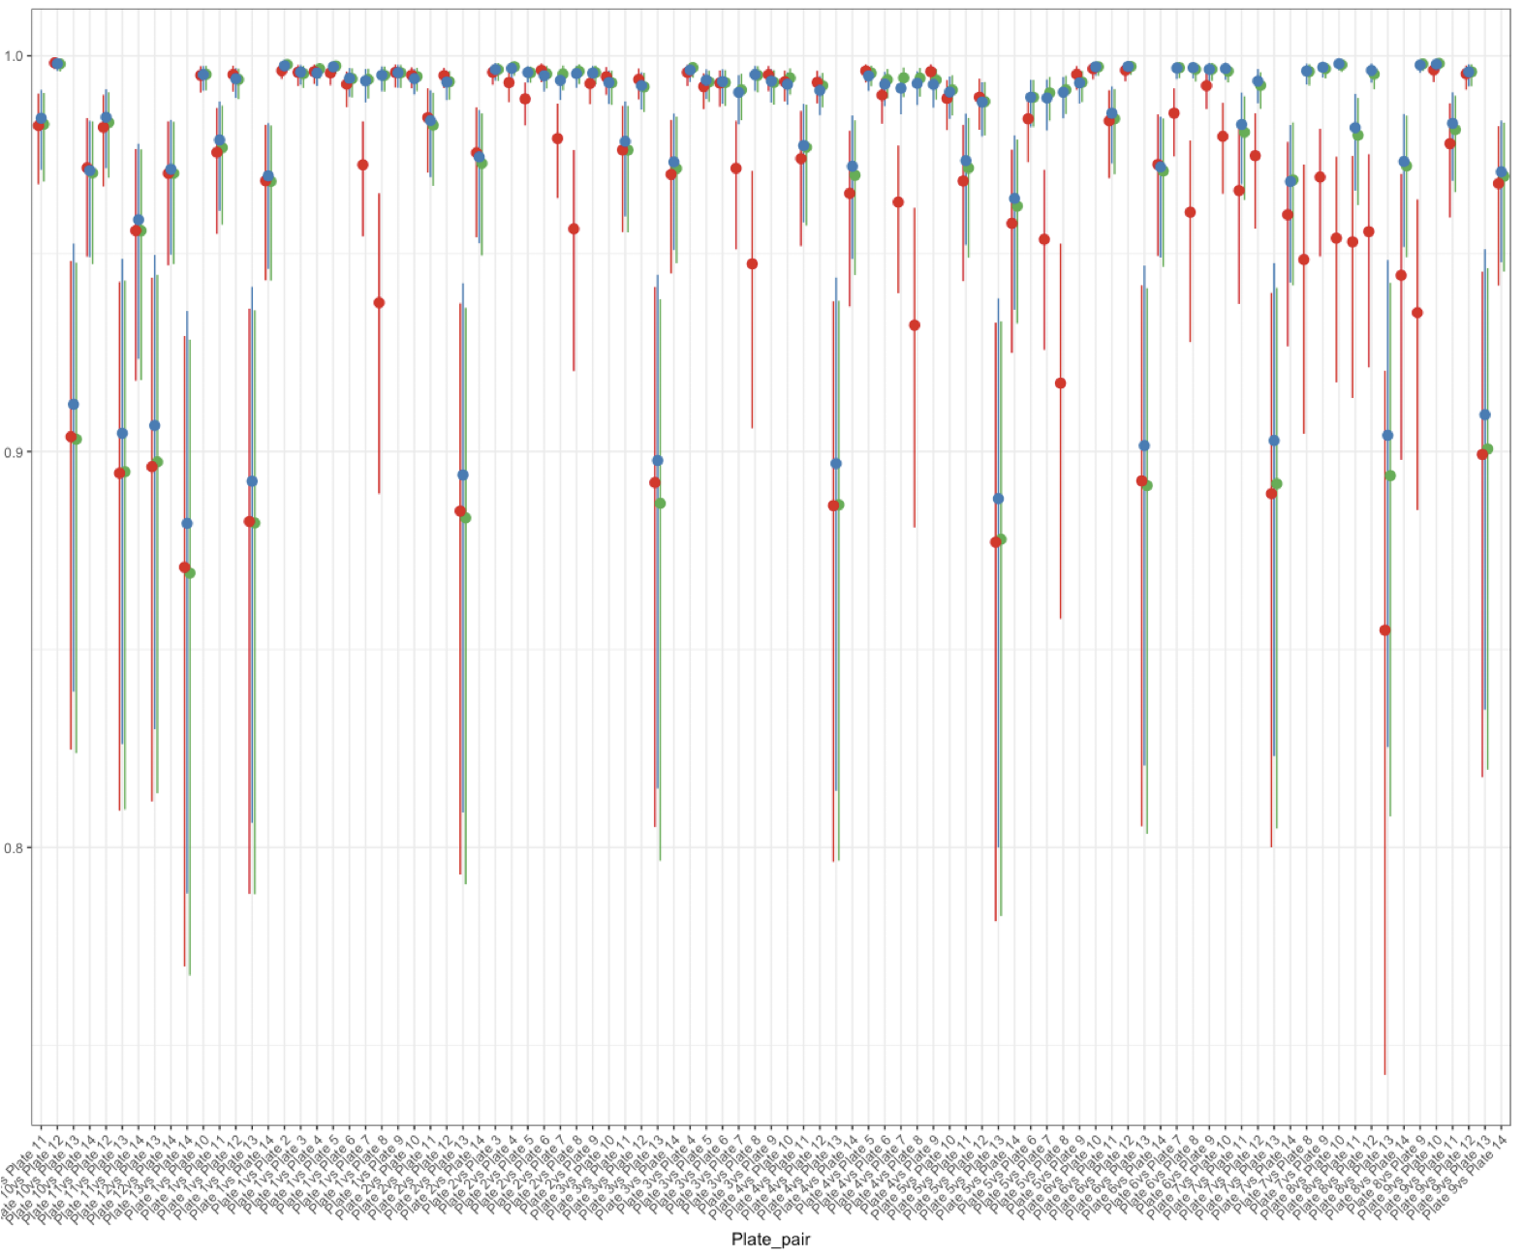
Optimal method for background correction may depend on the assay
MBA for malaria study (6 x 384 well plates, 19 P. falciparum antigens)
MBA for malaria study (14 x 96 well plates, 3 SARS-CoV2 antigens)

Slide 22
An example pipeline for pre-processing data

Slide 23
Transformation
Depending on the distribution of your data, you may want to transform it (eg log or Box-cox transformation) so that it fits a normal distribution
Show histograms of data before and after log transformation

Slide 24
Transformation
R code to do transformation, and look at histograms of data before and after log transformation showing that it becomes more normal

Slide 25
An example pipeline for pre-processing data
5. Fit standard curves and estimate log concentrations

Slide 26
Standardization
Standardization lets us go from units like MFI to units that can be compared between studies
We use samples that are run on each plate with known concentrations to fit a standard curve. This standard curve allows us to convert between units like MFI and other units like:
Relative Antibody Units (RAU)
International Units (IU): can correspond to WHO guidelines for protective immunity

Slide 27
Standardization
Show fitting standard curve to the data, show the standard curve, and show converting mfis to another unit

Slide 28
An example pipeline for pre-processing data
5. Fit standard curves and estimate log concentrations

Slide 29
Normalization
Normalization adjusts for differences between plates so that values between plates are comparable.
Methods for normalization:
One common method is using linear regression to estimate plate effects and adjust data
Sometimes there is no adjustment for normalization
More advanced methods exist that we won’t go through today

Slide 30
Normalization
R code demonstrating normalization and results of code

Slide 31
An example pipeline for pre-processing data
You may have alternative pipelines, eg skipping standardization only working with MFIs

Slide 32
Conclusion
Pre-processing is important because these steps can affect downstream inferences of data
Some of these steps may depend on the data, but pre-processing steps should be carefully considered

Slide 33
Extra slides

Slide 34
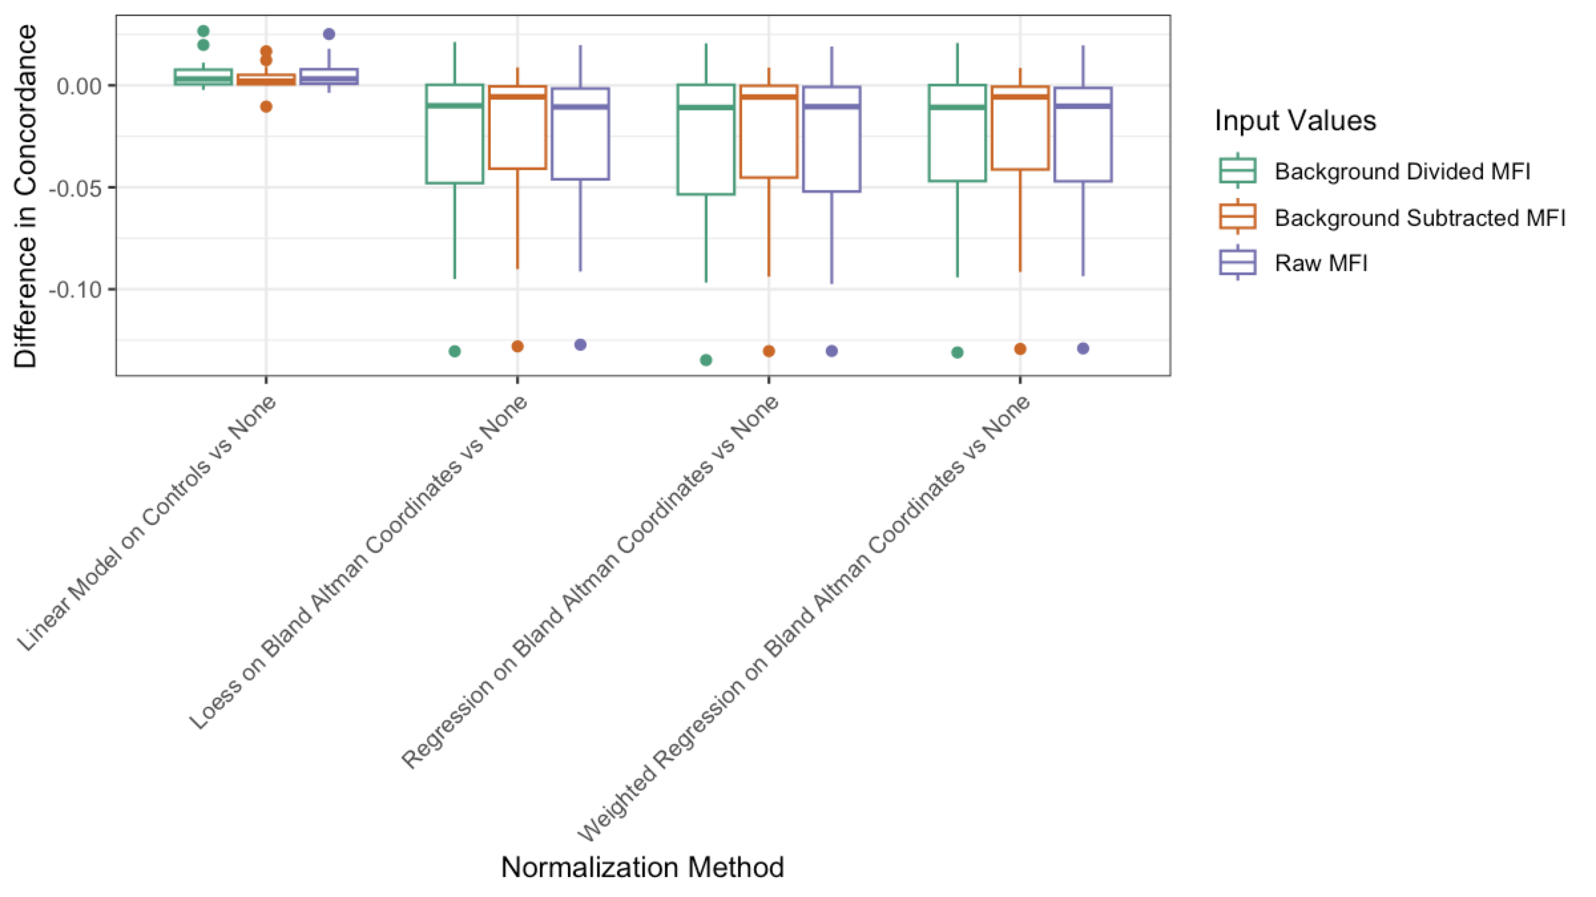
The right pre-processing minimizes technical variation

Slide 35
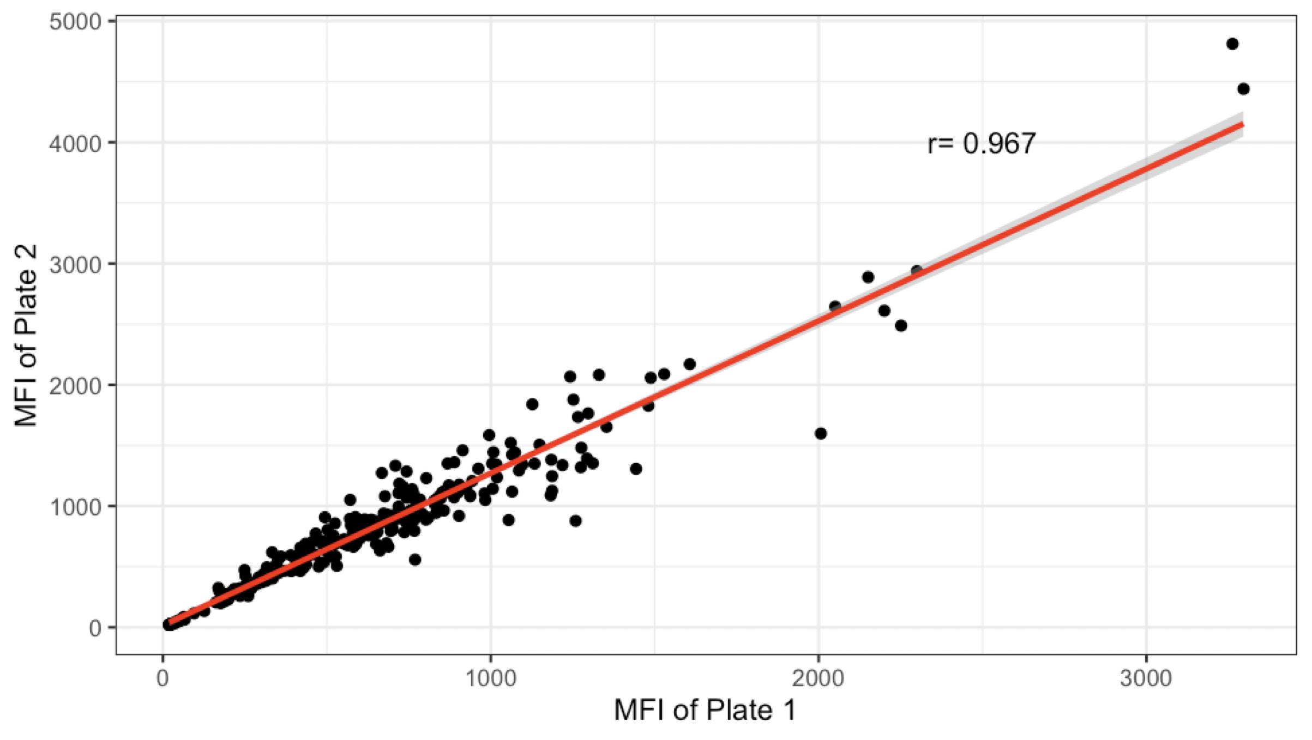
Running same samples on two plates
Notes:
Seems like similar values based on r

Slide 36
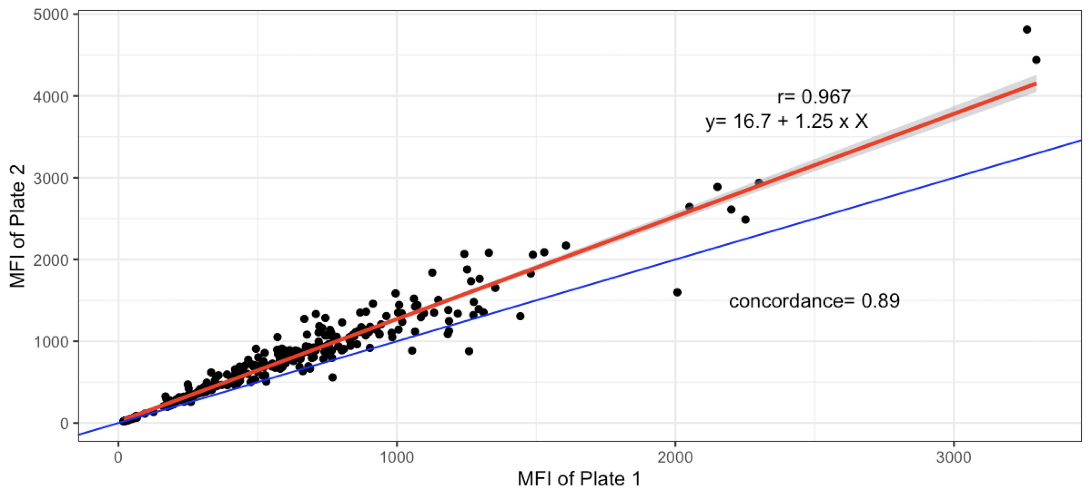
Running same samples on two plates
Must use concordance to evaluate whether values differ between plates, because distribution of values on plate 1 should be same as distribution of values on plate 2
- concordance is lower than r value
Notes:
how

